Slide 1

Improved Entrance Tank Design
4520 Final Project
Daniel Pyrek, Rosie Krasnoff, Hannah Weinstein, Barbara Oramah

Slide 2
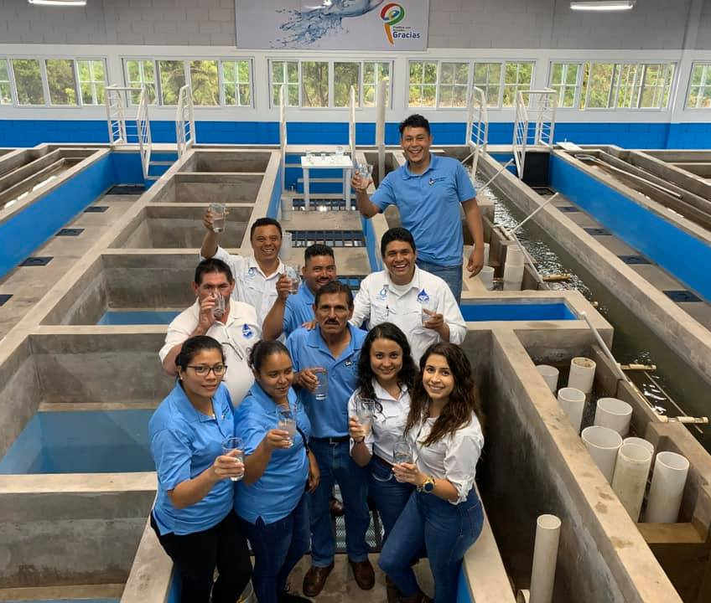
Background
The Gracias plant opened Fall 2019
Surprise! Influent water carries lots of sand and grit, especially during storms
Current Problem: Sand and grit in the flocculator, clogging manifolds in sedimentation tank
Opening of the Gracias plant

Slide 3
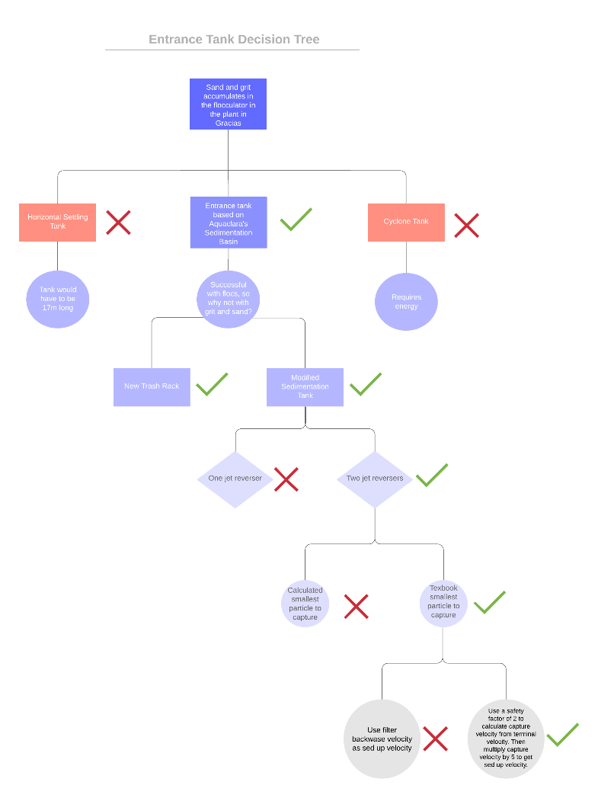
Decision Tree
On the edge of knowledge
Utilized Monroe’s guidance to estimate values with no experimental data
Highlighted estimated values for future students to explore further
Keep within the constraints:
No electricity
Limited space

Slide 4
Our Approach
sedimentation tank → entrance tank
settle sand instead of flocs
1 entrance tank for entire 120 L/s flow
Sloped into a drain at the end to collect sand and water to be drained

Slide 5
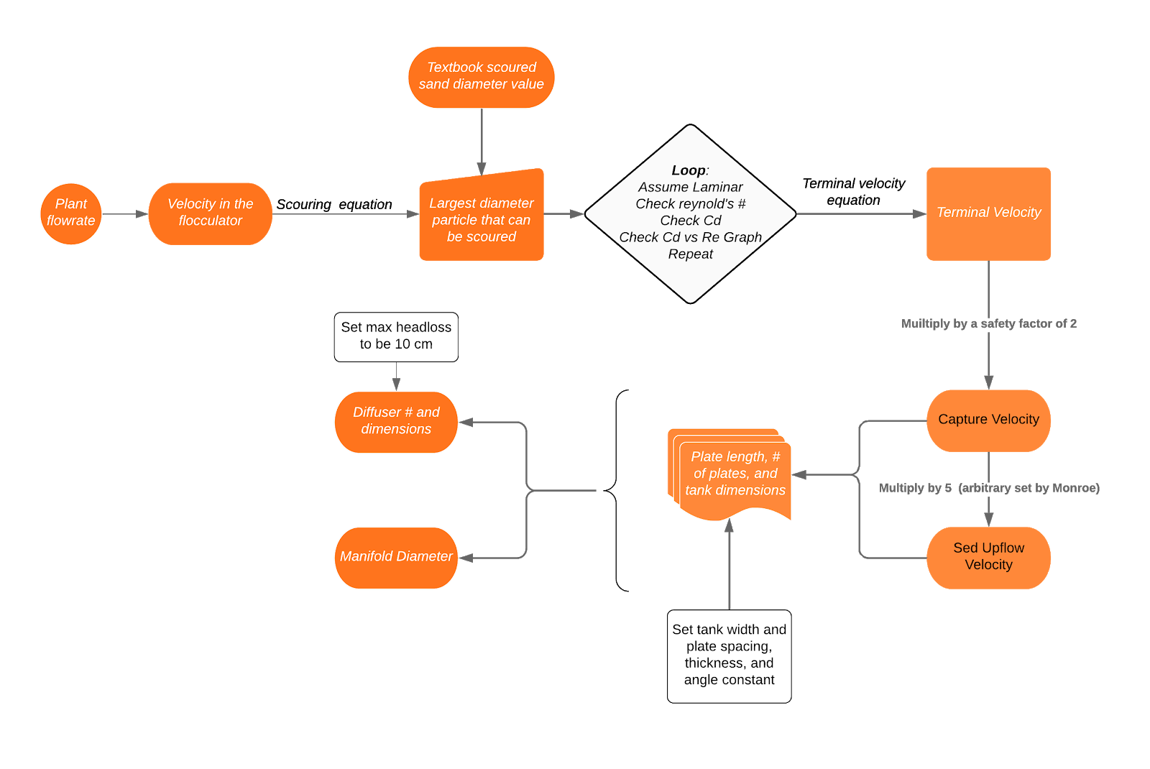
Design Steps

Slide 6
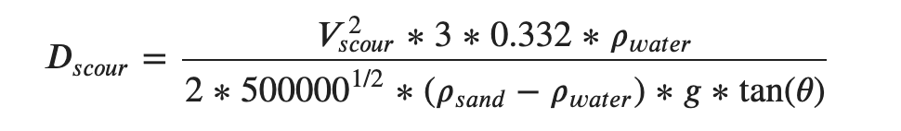
Finding Terminal Velocity from Scouring
Flocculator:
V_{scour} = V_{flocculator} Calculated diameter = 0.03544 mm (way too small!)

Slide 7
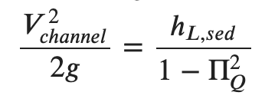
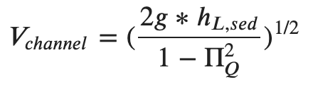
Finding Terminal Velocity from Scouring
Sed Tank Inlet Channel:
V_{scour} = V_{channel}
Calculated diameter = 5.206 mm (way too big!)

Slide 8
Design Calculations

Slide 9
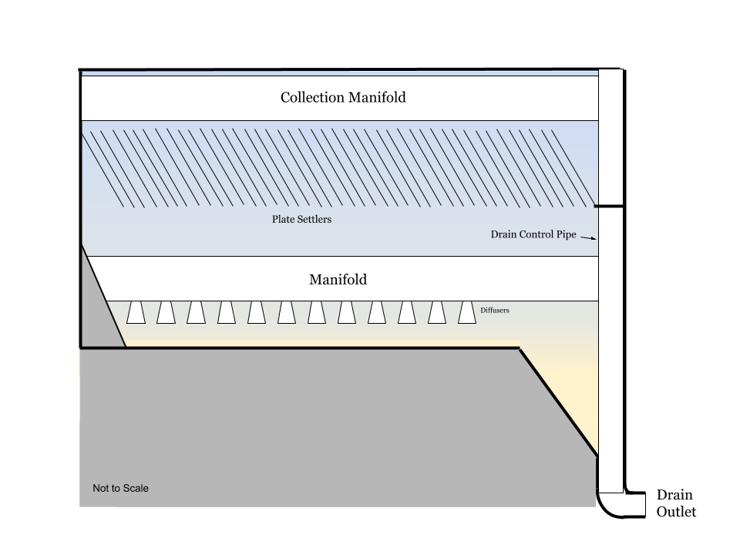
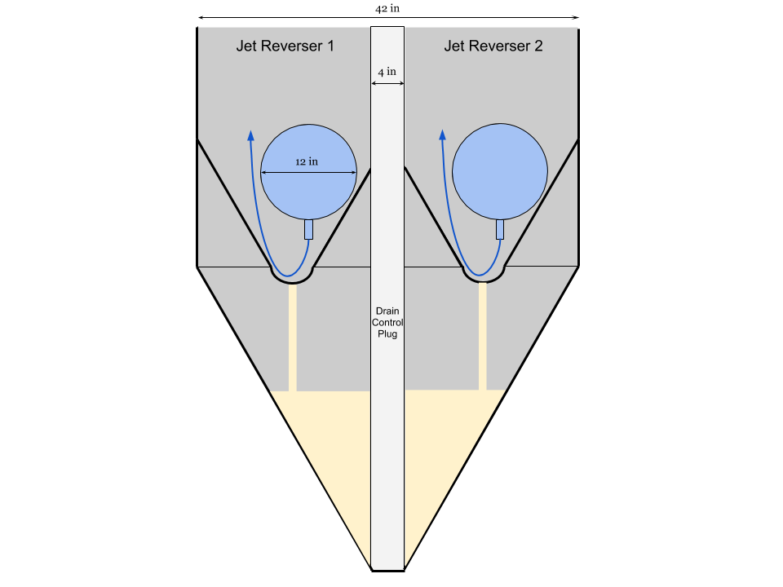

Slide 10
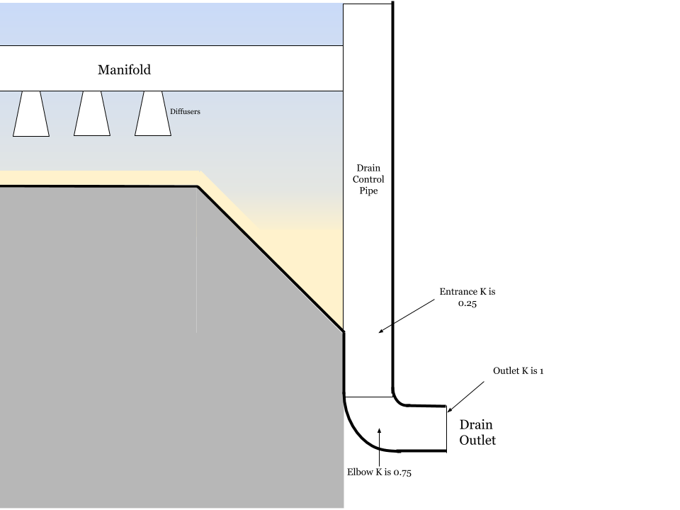
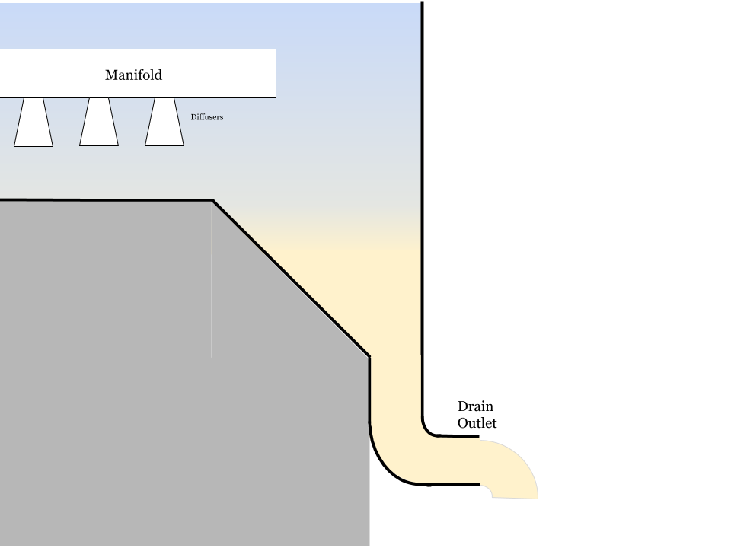
Drain Control Plug Pipe

Slide 11
Largest Sand (2 mm)

Slide 12
Smallest Grit (0.1 mm)

Slide 13
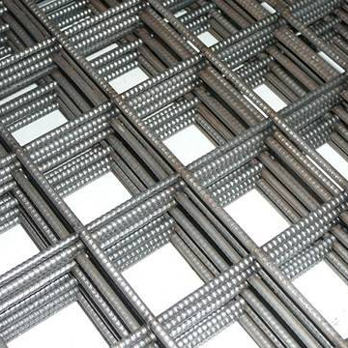
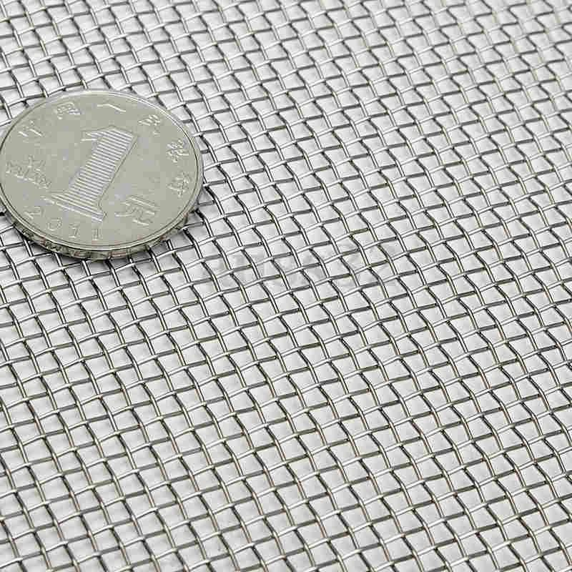
Trash Racks
Rebar mesh
d
r
US #10 mesh

Slide 14
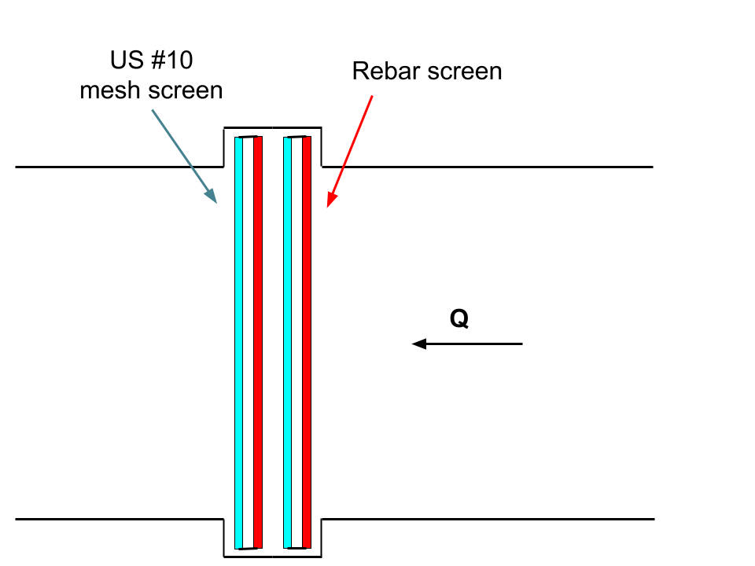
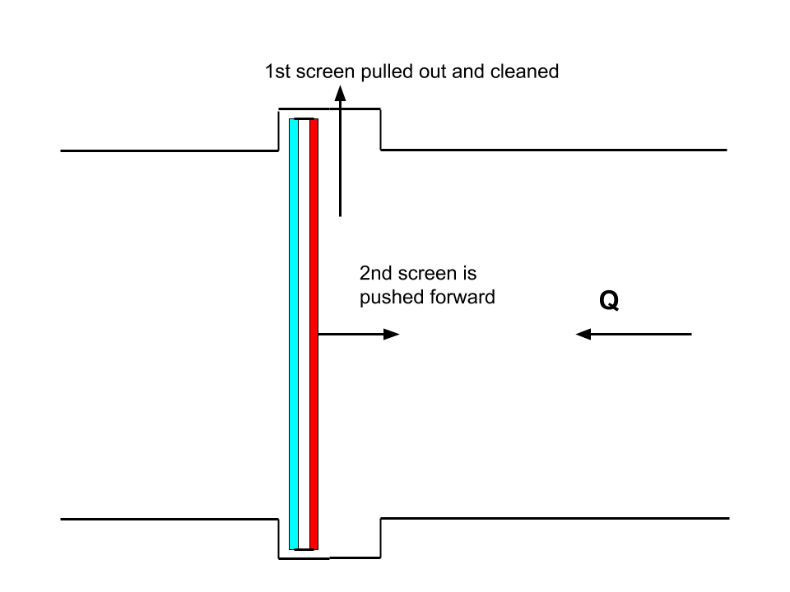
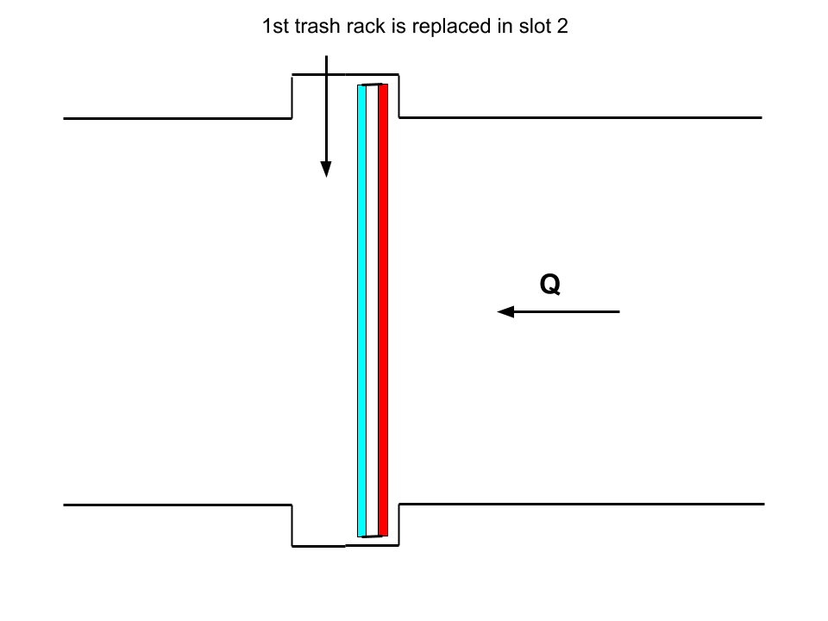
Trash Rack Design

Slide 15
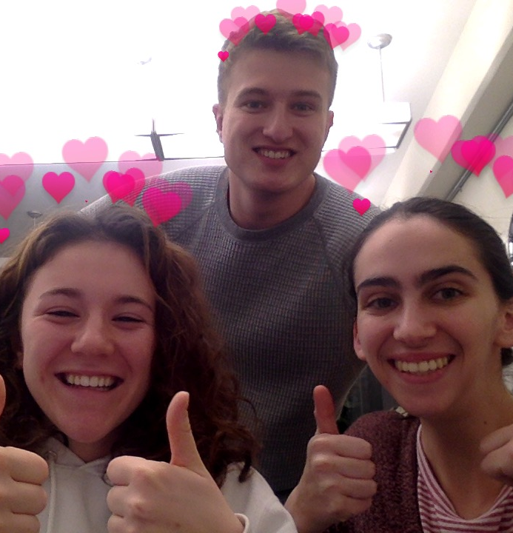
Conclusions:
Our Design:
Horizontal grit chamber requires 17 m length and 17 m² area
Entrance tank requires 6.25 m length and 6.25 m² area
Self cleaning, easy to drain
Future Design
Explore upflow, capture, and terminal velocities
Adjust plate spacing and angle
Better understand assumptions

